Slide 1
JOB PROSPECT OF DATA SCIENCE
FIROJ KAWSER JUBAYER
Standard Chartered Bank (Manager, Model/Scorecard)
Ex Brac Bank (Data Scientist)

Slide 2
What is the major advantage of data sceiene in terms of securing job?

Slide 3
Top Industries Hiring Data Scientists
IT and Technology
Healthcare
Retail
Finance and Banking
Manufacturing

Slide 4
Skills Required for Data Science Jobs
A. Technical Skills
Programming languages
Python
R
SQL
SAS/MATLAB etc.
Machine Learning Algorithms
Data Visualization tools
Power BI
Tableau
B. Soft Skills
Communication
Problem-solving
Creativity
Business acumen

Slide 5
Popular job titles in data science
Data Scientist
Data Analyst
Machine Learning Engineer
Business Intelligence Analyst
Data Engineer

Slide 6
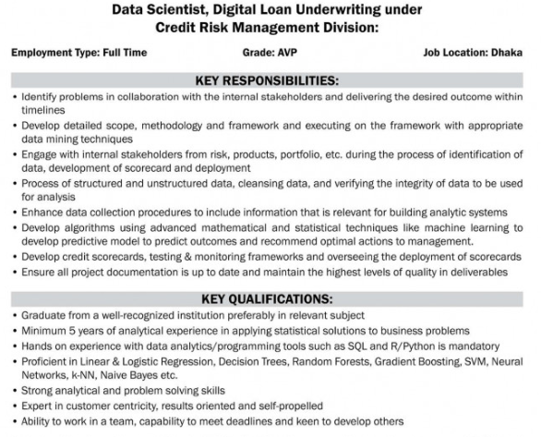

Slide 7
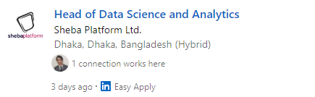
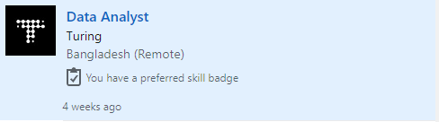
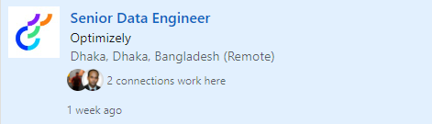

Slide 8
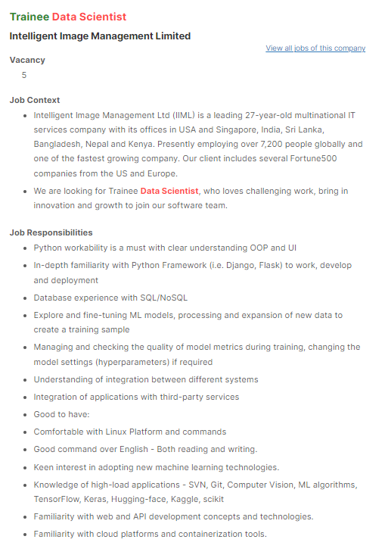

Slide 9
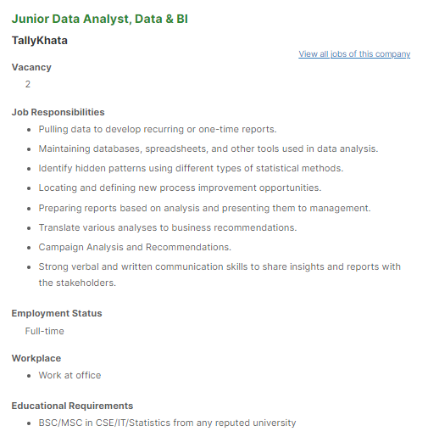

Slide 10
CAREER GROWTH OF DATA SCIENCE
SENIOR DATA SCIENTIST
MORE SPECIALISED TITLE- SCORECARD/RDF
DATA SCIENCE MANAGER
DATA ENGINEER

Slide 11
WHY DATA SCIENCE IS IMPORTANT FOR ANY COMPANY?

Slide 12
WHY DATA SCIENCE IS IMPORTANT FOR ANY COMPANY?
COST
EFIECIENCY
PRODUCTIVITY
INFORMATION

Slide 13
SALARY
WHICH TITLE GET THE MOST SALARY?
ANY GUESS?

Slide 14
MEDIUM TO FIND JOBS
BDJOBS
LINKEDIN
REFERENCE

Slide 15
MAKE YOURSELF ATTRACTIVE TO THE EMPLOYER
MAKE PORTFOLIO AT GITHUB
WRITE ARTICLE
SOLVE STACKOVERFLOW QUESTION
ATTEND COMPETITION

Slide 16
DON’T USE POPULAR DATA FOR MAKING PORTFOLIO

Slide 17
ANY QUESTION?

Slide 18
Interview guideline
Review your resume and cover letter
Be ready to ask questions about the company and the job
Prepare the answers to the most common questions
Python
SQL
R
Statistics

Slide 19
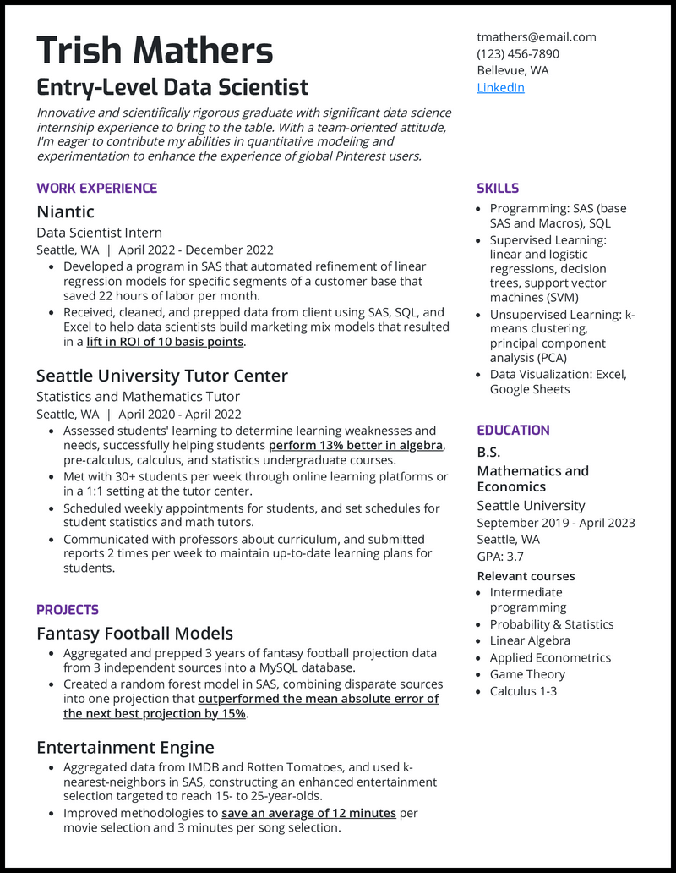

Slide 20
What are behavioral interview questions?
Behavioral interview questions help you delve into a candidate’s experiences and how they’ve demonstrated certain personality traits and behavioral characteristics at work.
Tell me about a time you encountered a disagreement within your data science team while working on a project. What steps did you take to resolve the conflict?
Tell me about a project where the data landscape changed unexpectedly midway through your analysis. How did you adjust your approach to accommodate these changes, and what strategies did you use to ensure the project's success despite the unexpected challenges?
Describe a situation where you had to communicate with a non-technical audience. How did you tailor your communication to ensure they understood your message?

Slide 21
What is the next step?
Practice for interview.
Learn SQL
Learn advanced statistics
Learn advanced python
Create portfolio

Slide 22
Most common question
What is multicollinearity?
What is the difference between Supervised Learning and Unsupervised Learning?
How can you overcome Overfitting?
What does P-value signify about the statistical data?
Why do we use A/B Testing?
What is the use of the R-squared value?
Explain the central limit theorem.
How will you find the right K for K-means?
What is a confusion matrix

Slide 23
Most common question
What is pruning in a decision tree algorithm?
What is a bias-variance trade-off in Data Science?
Type 1 and Type 2 error
What sensitivity and Specificity?

Slide 24
Resources
Books:
Data Science from Scratch- By Joel Grus
Practical Statistics for Data Scientists: 50+ Essential Concepts Using R and Python By Peter Bruce, Andrew Bruce, Peter Gedeck
YouTube:
Channel Name: Stat Quest with Josh Starmer
Udemy::
100 Days of Code: The Complete Python Pro Bootcamp for 2023

